Slide 1
Insights Phase D
FinAct Integration Design Overview
September 2025

Slide 2
High-Level Overview

Slide 3
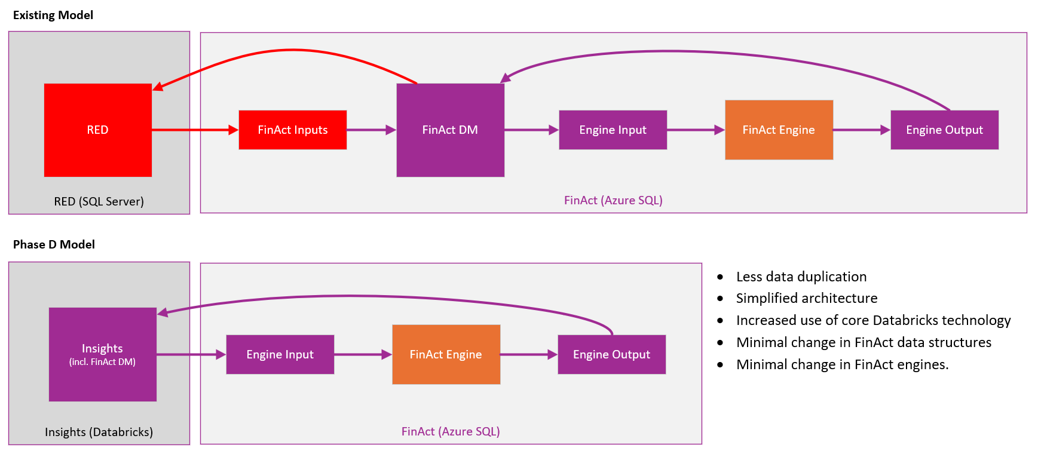
Overview
Objective and Scope
  Remove dependencies on RED by integrating FinAct with Insights
  Remove data duplication that currently exists from FinAct DM existing separately to Insights
  Minimise change to the FinAct engines which are recently developed and considered strategic
  FinAct becomes a series of calculation engines, closely coupled with data in Insights
  FinAct will remain in Azure SQL to minimise change, risk and rework
  Finance downstream and reporting processes such as TPs need to continue to work but won’t be ‘enhanced’
  General approach is make FinAct DM part of the existing Insights DWH and deal with the impacts that arise from this.
Proposed Approach
  FinAct DM is the data used by / created in FinAct. It is currently fed from RED and is then the data source for the ‘Engines’.
  FinAct DM will become part of Insights, simplifying the architecture and minimising data duplication.
  The FinAct engines will be largely unchanged other than if they directly interact with RED data.

Slide 4
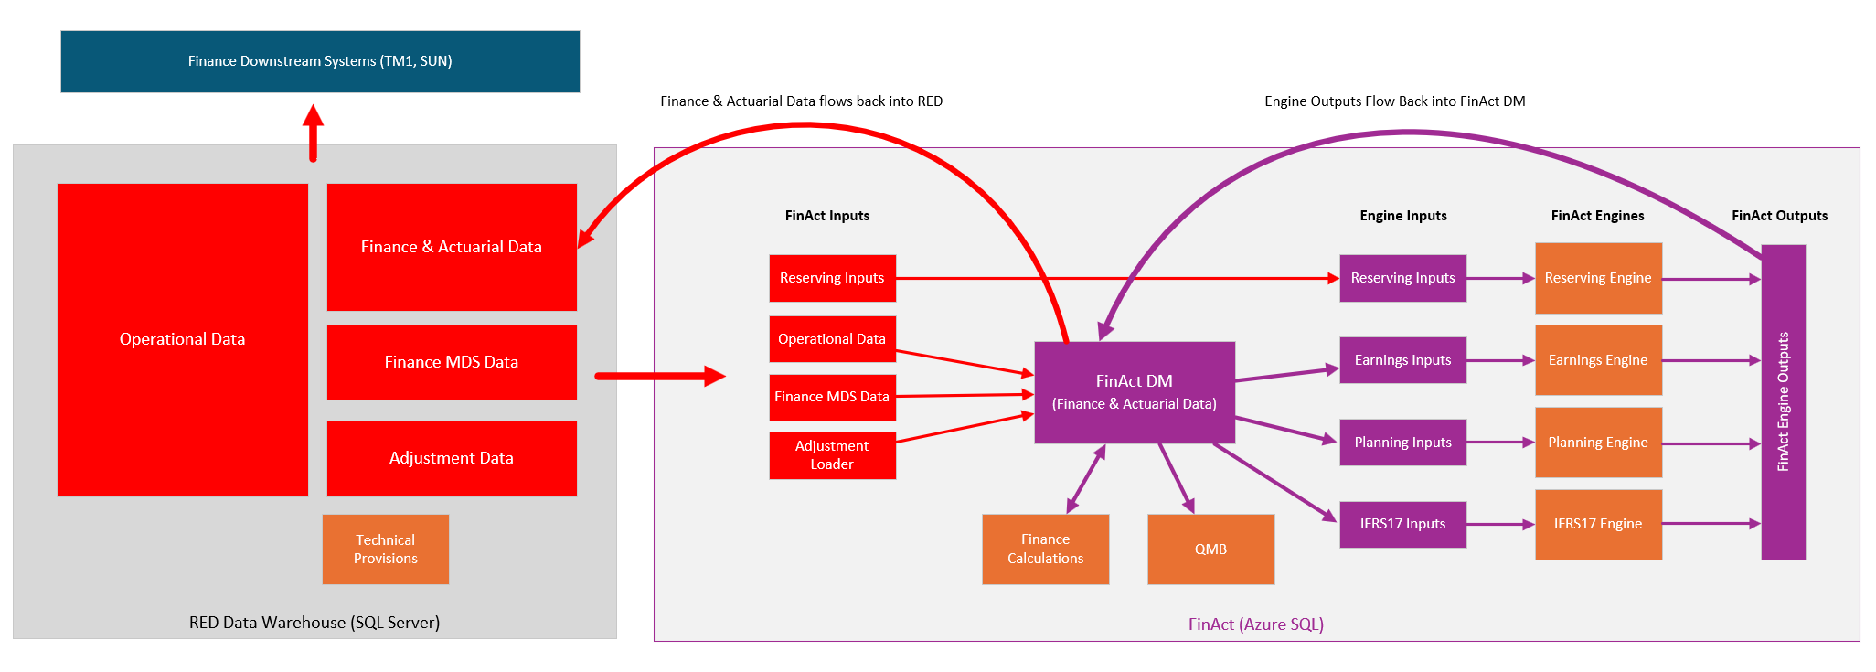
Current FinAct High-Level Overview
Key Points
  FinAct DM (dataset for all operational and Finance and Actuarial data used in FinAct) exists within the FinAct application, separate to RED.
  Operational data flows from RED into FinAct and then from there on into FinAct calculation engines
  Calculation engines send results back into FinAct DM
  Finance and Actuarial data is then sent back to RED from FinAct DM with downstream Finance feeds and TPs being run in the RED environment
  FinAct data is duplicated between FinAct and RED.

Slide 5
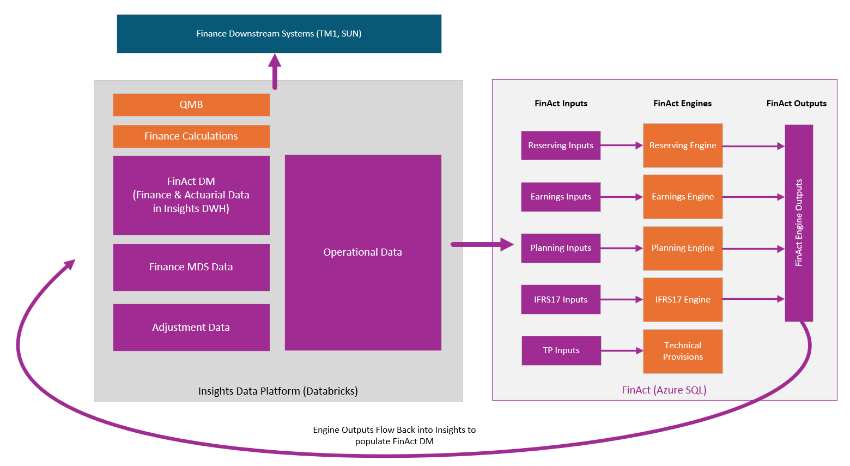
Phase D Insights FinAct High-Level Overview
Key Points
  FinAct DM (dataset for all operational and Finance and Actuarial data used in FinAct) becomes part of the core Insights model and no longer lives in FinAct.
  No longer a need for this data to be fed wholesale into FinAct. FinAct engines are fed directly from Insights.
  Engines themselves are largely unchanged but now send their outputs back to Insights directly.
  Finance Calculations and QMB move into Insights alongside the FinAct data. TPs may become a dedicated engine within FinAct (TBC)
  FinAct data is not duplicated between FinAct and Insights establishing a single version of the truth and minimising data flows.

Slide 6
Data Model Overview

Slide 7
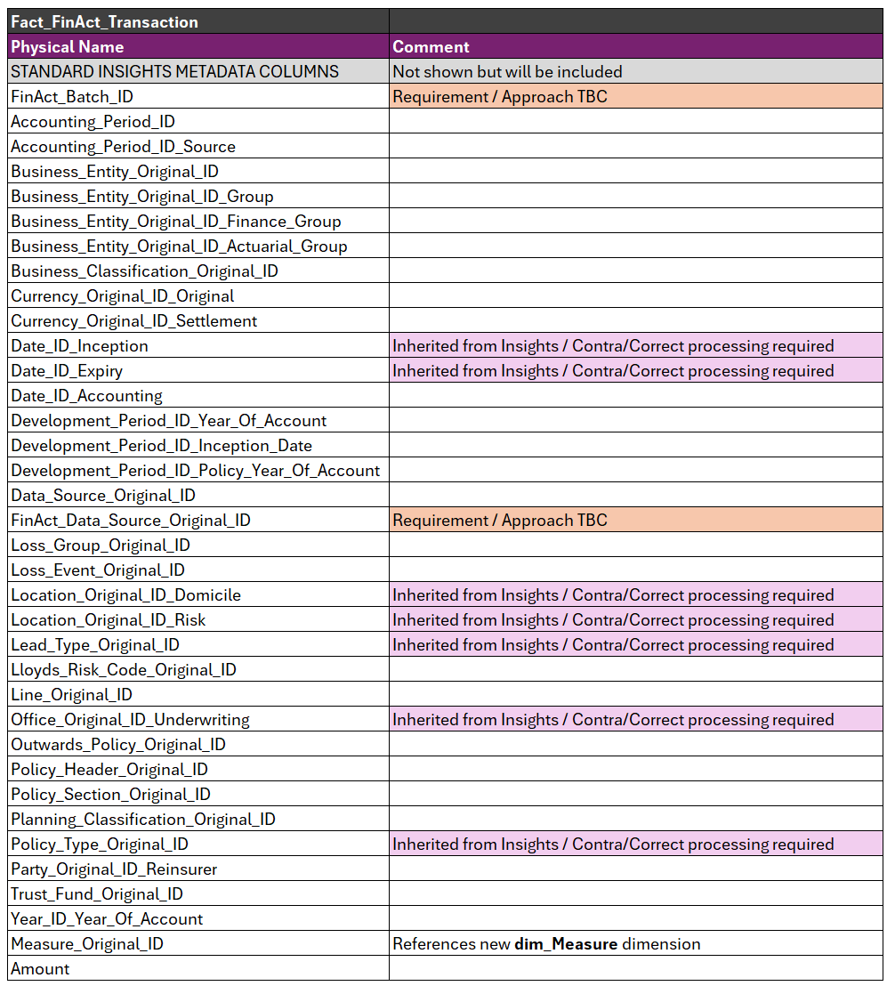
FinAct DM Data Model
Overview
  FinAct DM becomes part of the existing Insights DWH model
  A new Fact table (fact_FinAct_Transaction) is introduced
  A new Dimension (dim_Measure) is introduced
  Otherwise references existing Insights dimensions
  Reflects existing FinAct fact table design with unused columns removed and dimensions replaced by existing Insights concepts (e.g. Outwards Policy, Reinsurer, Loss Event)
  Uses Original_IDs rather than IDs for all concepts to simplify reporting and minimise the need for contra/correct transactions to handle slowly changing dimensions
  Columns inherited from policy data in Insights will require an on-going process to create contra/corrects
  FinAct Data Source, Batch ID and potentially some additional historical fields may become candidates for inclusion on dedicated dimensions or potentially a dim_FinAct_Transaction dimension.
Key points
  Existing FinAct measure structure will be maintained
  This includes existing handling of OCC and SCC as separate measures
  Data content of the fact will remain consistent with FinAct and therefore contain operational as well as FinAct data.

Slide 8
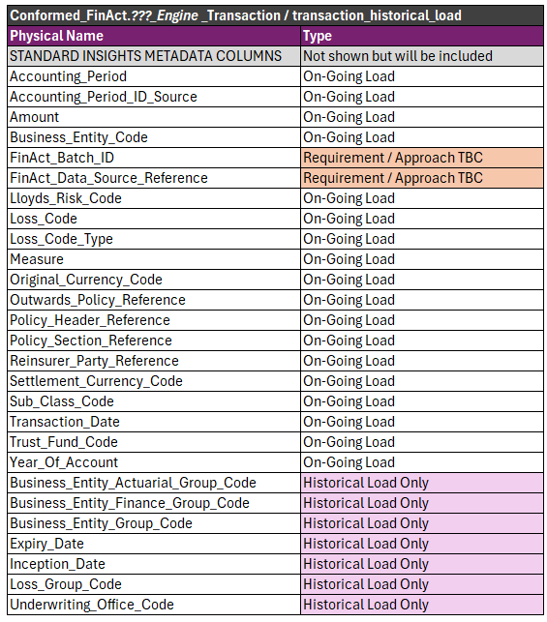
Conformed Model
Overview
  Conformed model aligned with common output from FinAct engines.
  Each engine maintains its own common table across Raw, Standardised, and Conformed layers. E.g. earnings_transaction, reserving transaction etc.
  This structure supports alignment with the current design of the Insights platform and makes incremental loading more straightforward
  New measure entity will be loaded from Insights MDS
    An additional column has been introduced to support Insights-specific naming conventions.
    In FinAct, the measure uses a friendly name, which is functionally equivalent to the measure name.
  A separate extended version of the conformed transaction table will be used to hold historical data migrated from FinAct to allow historical attributes to be retained. This table will be subject to a one-off load
  Raw and Standardised models largely mirror Conformed.
Key points
  On-going load from FinAct to Conformed will involve little transformation as common output format from FinAct will provide required information
  Historical load will need to map FinAct concepts to Insights Conformed model
    Separating inwards and outwards policy concepts
    Mapping to Loss Event data from Event / Event Group
    Mapping to Reinsurer parties.

Slide 9
FinAct to Insights Data Flow

Slide 10
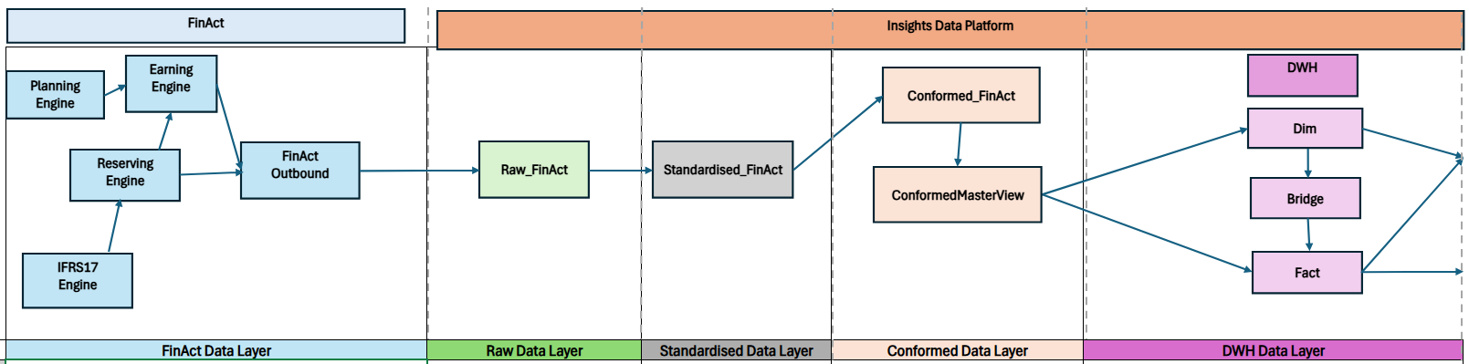
FinAct to Insights Load
Overview
  The FinAct engines will create output data within a new FinAct Outbound schema in FinAct
  Outputs from all engines that need to feed Insights will be in a common format
  FinAct Outbound data will be ingested into Insights into raw layer and then into subsequent data layers till DWH
  Data load process will follow standard Insights load processes, batch control etc.
  One-off historical load process will follow the same process but require specific notebooks to maintain additional columns
  Current focus is on building/testing this process with ~6BN rows of historical data from FinAct.

Slide 11
FinAct to Insights Load
Key Points
  Process will follow standard Insights load processes
  FinAct will run separately to main Insights load to allow it to run on-demand when FinAct data needs to be loaded
  FinAct Engine > Raw > Standardised processes will be able to be run in parallel as with existing Insights sources
  Standardised > Conformed > DWH will run as a single FinAct batch, processing data from any Engines with new data
  Only a single FinAct batch (Standardised > Conformed > DWH) will be able to run at a time. This is not anticipated to be an issue.
On-going / Outstanding Design Areas
  Aim to minimise interaction between main load and FinAct load, but contra/correct process will be needed for some FinAct dimensions
  E.g. when Subscribe load updates policy inception dates, a process will be needed to reflect this in the FinAct fact
    #1: Have FinAct process which looks for relevant changes and applied them when needed
    #2: Have Subscribe load process manipulate the FinAct fact.
    Option 1 preferred as this removes interactions between the data loads. It however creates a timing difference between the facts which itself has pros and cons.
  Incremental vs full extracts from FinAct engines. We will need to understand whether FinAct engines provide full or incremental datasets via the common output format. This will have some impact on if/how data needs to be deduplicated between Raw & Standardised and/or between Standardised and Conformed.
  Use of common data flows and storing data in Conformed for non-Engine sources.
    Finance / Parent Calculations: simpler to re-factor on the DWH but would be fact-to-fact load process.
    Operational data loads (EPI, Signed, Claims, RI etc.) from Insights: in some ways simpler to load back through raw > standardised > conformed etc.
    In both instances this is largely a decision around whether we want/need the full dataset in Conformed or not.

Slide 12
Insights to FinAct Data Flow

Slide 13
Insights to FinAct Overview
Problem Statement
  Dependencies on RED need to be removed and FinAct DM will no longer exist in the FinAct Azure SQL environment
  The FinAct engines have dependencies on RED and FinAct DM data both on input data and within the engines
  Within Phase D the aim is to minimise change within FinAct across the engines
    Earnings Engine
    Reserving Engine
    IFRS Engine
    Planning Engine
    QMB Engine
  General Approach
  Solution: Redirect data dependencies from RED and FinAct DM in the Engines code to source data from Insights
  Reserving Feed rebuilt from Insights replacing existing feed fed from RED
  Earnings Feed refactored from Insights FinAct fact table
  Additional interface of common reference tables fed to FinAct engine staging layer from Insights to remove dependencies.

Slide 14
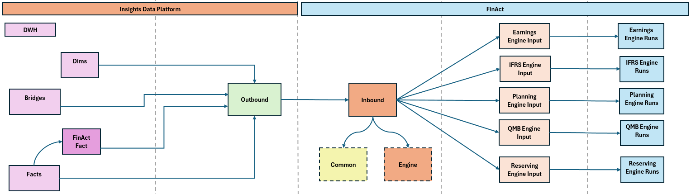
Insights to FinAct Overview
Overview
  Data movement from Insights to FinAct staging tables to feed engines
  Insights data is read into an Outbound data layer (views)
  The Outbound data is pushed from Insights into the FinAct Inbound data layer (tables)
  Inbound data is read by FinAct engine code and written into existing Engine Input tables
  Engine code runs in FinAct reading data from the Engine Input tables

Slide 15
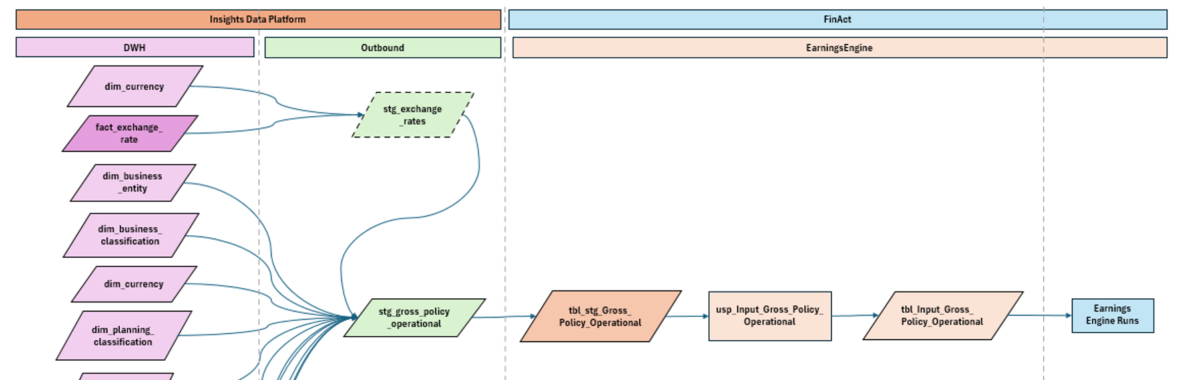
Example Flow
  Overview
  Existing FinAct code will be retained where possible with inputs replaced rather than being fully restructured
  Example data flows for the Earnings Engine feeds shown below and next slide
  In this example gross_policy_operational is sent from Insights but existing SQL procedures continue to run within FinAct to provide final engine input data
  Processes will remain orchestrated / triggered from FinAct due to parameterisation of input data.

Slide 16
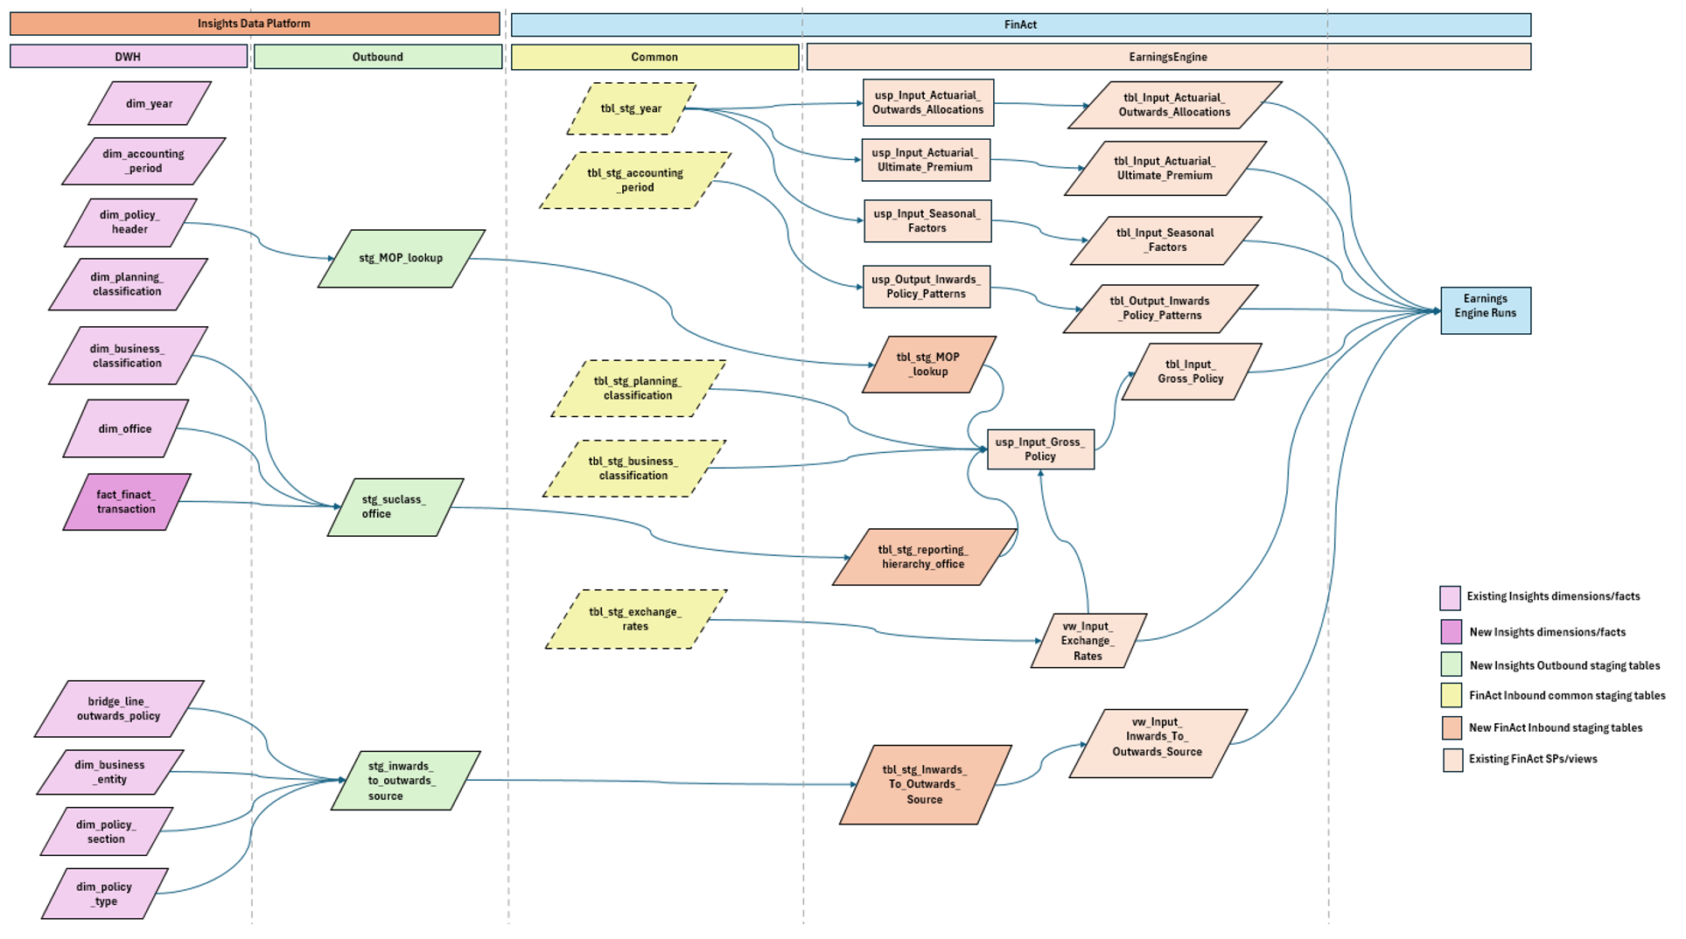
Example 2

Slide 17
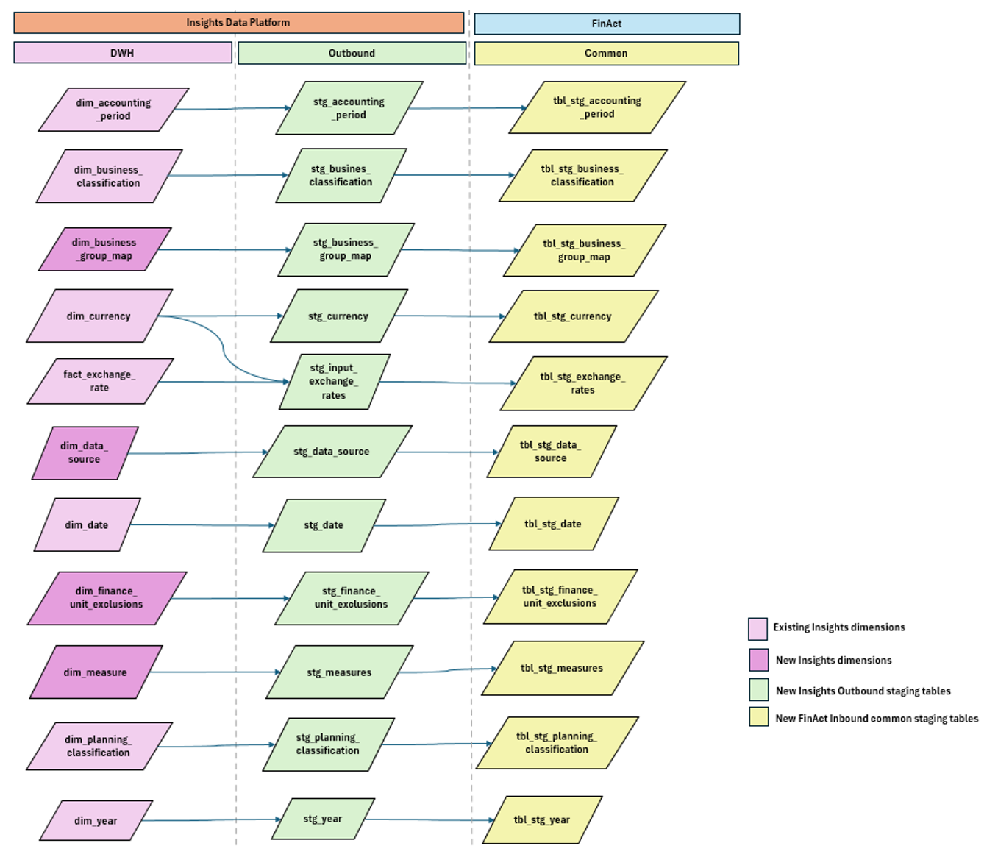
Common Data Feeds
Overview
  A new FinAct common input area will include data tables fed from Insights that can be referenced within Engines where needed to remove direct use of FinAct DM
  These are generally small reference data tables or in some instances lookups
  Will minimise these but the following are examples that may be required:
    Accounting periods
    Currencies
    Years
    Dates
    Measures
    Business / Planning Classification
    Exchange Rates
  It is assumed that these will be sent daily as will be driven by changes in the main Insights load rather than by FinAct processing.

Slide 18
Engine Specifics: work in progress

Slide 19
Other Engine Changes
Reserving System / Feeds
  OSIL data has been ingested into Databricks and will be integrated into the Reserving feed directly
  Integrating this data into Insights fully is not being undertaken at this stage
  RS036 / Inwards Reinstatement Premiums. This logic is currently being developed within the Reserving feed with the assumption that this then provides a specification that would allow this to move back into core Insights
  Assumption that Reserving feed is amended to receive Loss Event / Loss Group information from Insights
  This is for discussion with Chris Booden but would result in the Loss Event / ALC processing being removed from the Reserving Engine with the information becoming a pass-through from Insights.
General Changes
  Separation of inwards and outwards policy concepts in FinAct data to allow outwards policy to be provided in common output format
  Adoption of Reinsurer_Party_Reference where required across FinAct engine inputs / outputs
  Development of common extract format from each engine feeding back into FinAct DM.
  …….TBC

Slide 20
Earnings Engine
4 types of data dependency on FinActDM/RED that will be sourced from Insights
Common data
Accounting Period
Business Classification
Exchange Rates
Planning Classification
YOA
Lookup data
Policy Section Method of Placement lookup - Gross Policy engine input data
Reporting Hierarchy Office (Subclass/Office combinations) - Gross Policy engine input data
Inwards to Outwards source – Engine input data
Gross Policy Operational
Reinsurance Policy Operational
Gross Policy/Reinsurance Operational load routines to be refactored in Insights
Orchestration changes (ADF) required to pre-load the above data via Insights notebooks before running main Earnings Engine process

Slide 21
Reserving Engine
Reserving Feed source data to be sourced from Insights instead of RED::
Refactor these FinAct Reserving report SPs to source data from the FinAct DWH reserving feed output tables rather than FinActDM:
usp_RiAccountedIncomes_GetGrossPremiums
usp_RiAccountedIncomes_GetRiPremiums
Data Flags (used for ETL process)
OSIL Data
Claims
Event Group
Reporting Hierarchy
Business Entity
Policy
FX Rates
Gross/RI Transaction data

Slide 22
PLANNING Engine
Minimal FinActDM data dependency to be redirected to Insights (YOA and Date)
Gross Policy Operational data to be preloaded by refactored Earnings Engine code before generating a new plan (usp_Generate_New_Plan)

Slide 23
IFRS Engine
Data depedancy on FinActDM to be redirected to Insights:
Existing load routines to be partially refactored in Insights
Orchestration changes (ADF) required to pre-load the FinActDM data incrementally via Insights notebooks before running existing main IFRS process
Fact Transaction data for IFRS measures
Supporting measures e.g. Business Entity, Reporting Hierarchy, Currency etc.

Slide 24
QMB Engine
Exchange rate data to be sourced from Insights
Aggregated FinActDM base figures data to be sourced from Insights
Load routines for the above to be refactored into Insights and pre-loaded before calling main QMB engine run

